Slide 1
Findable Accessible Interoperable Reusable
}
Scientific Data @ ILL
Bonus: metrics
PaNOSC Annual Meeting - Trieste

Slide 2

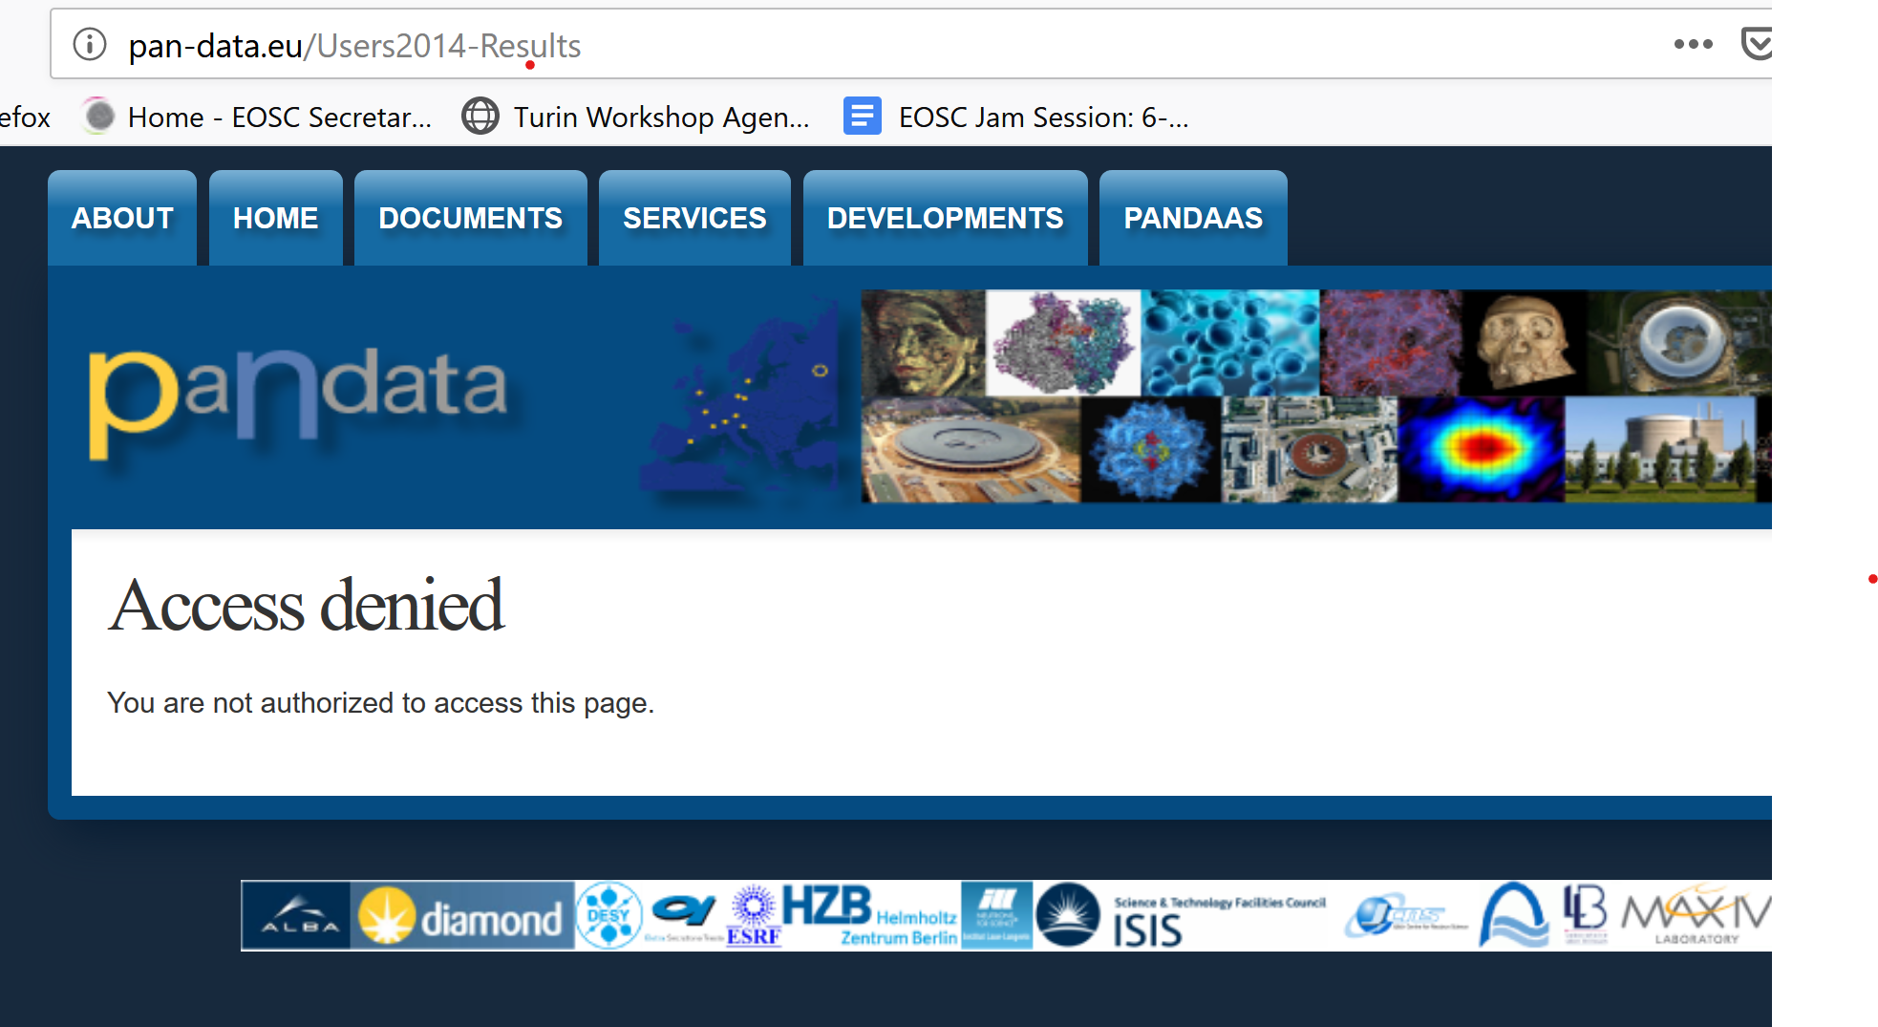
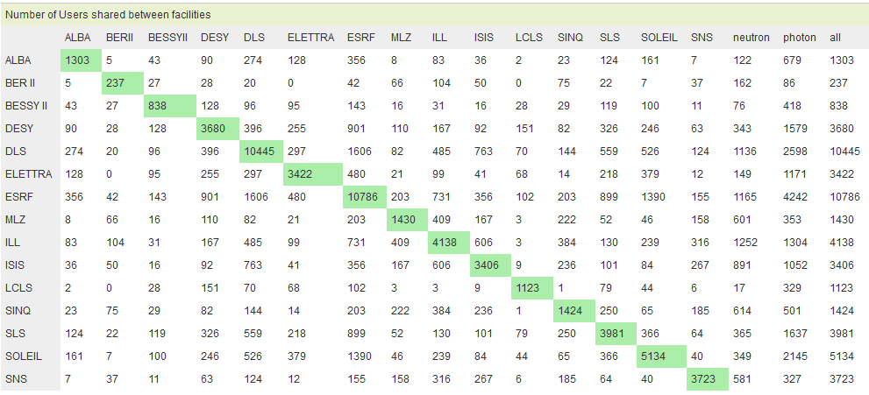
We are not alone
Snapshots of unique X-Ray & Neutron scattering users, over 18 months (2013 – 2014).

Slide 3
Accessible: DP
Scientific data policy
Open Data policy based on PaNData-EU work.
Published in Sept 2011
In place since Oct 2012 (i.e. 1st experiment under DP)
2013 complete set of Data Management Services available for users: search, access, annotate, archive, identify, publish.
Revised In July 2017
Include per default CRG instruments
More practical : “PID” replaced by “DOI”
All type of scientific data (Raw, reduced and results stored on ILL infrastructure)
Completely rewritten by a scientist to simplify wording and make it more practical and understandable by users.
https://www.ill.eu/DataPolicy

Slide 4
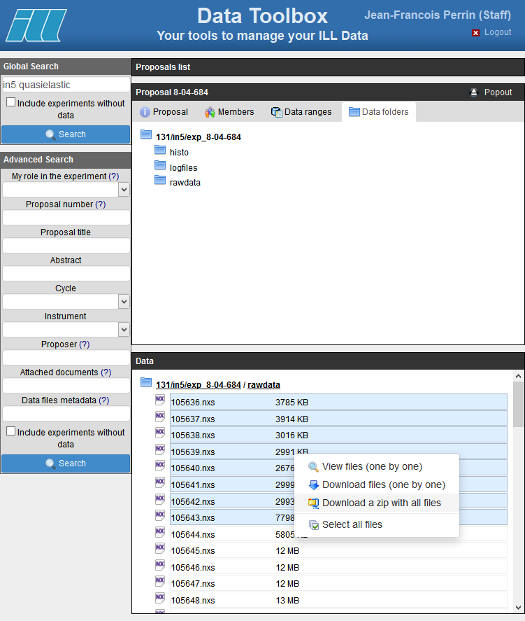
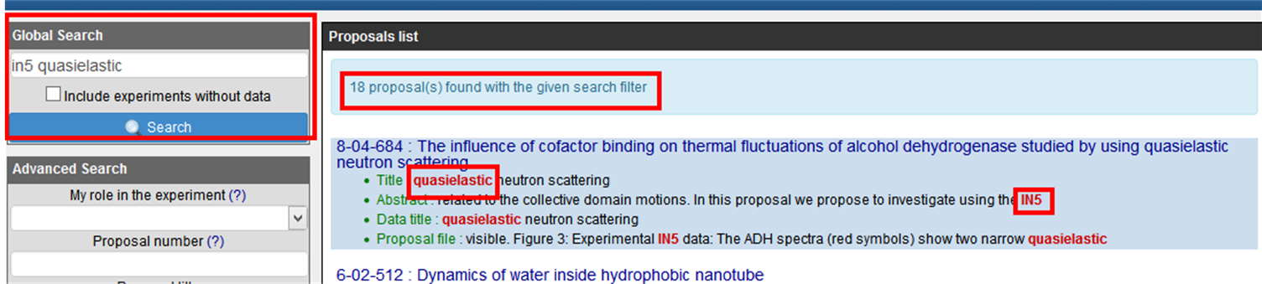
Accessible: Data Portal
Provide access to data, meta-data, logs, DOIs landing page, …
Tools for managing data authZ
Tailored to ILL needs
User management of data access authorization.
Users could decide to publish (open access) their data, before the end of the embargo period.
Linked to DOIs.
Linked to experimental logs.
Linked to user annotation tool.
Linked with proposal system.
Download of data.
Full text search
Index all available information: Proposal, experimental report, data file annotation, publications, …

Slide 5
Accessible: User Data Transfer
Data Portal
SFTP server frontend to the archive (GFPS)
« Ad-hoc » Rsync for some special cases
Local copy (uncountable)
New tool (globus online, …) -> WP6
Real take off of the data portal

Slide 6
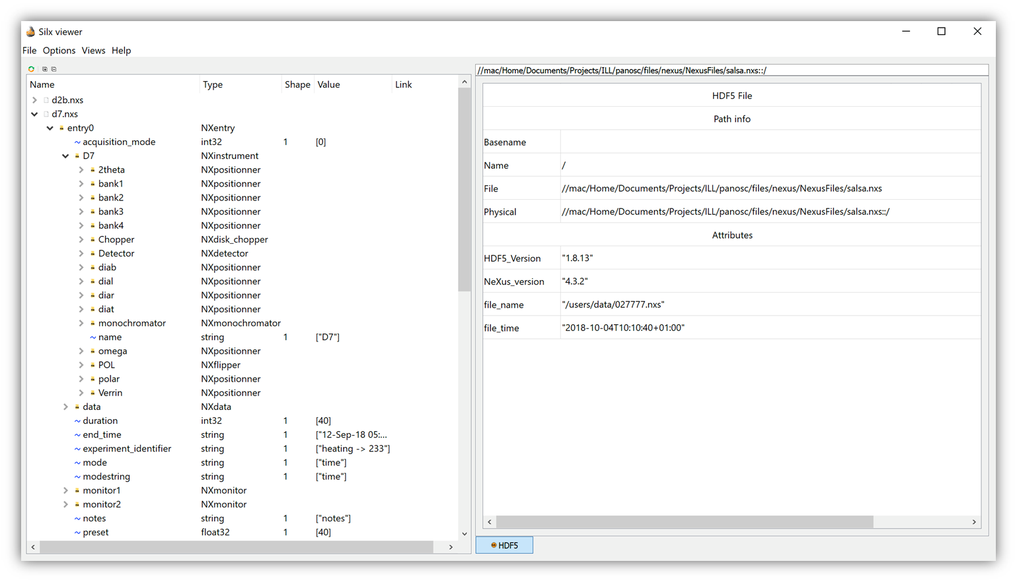
Interoperable
File formats
ROOT for Nuclear Physics/HEP experiments.
NeXus for all the other instruments.

Slide 7
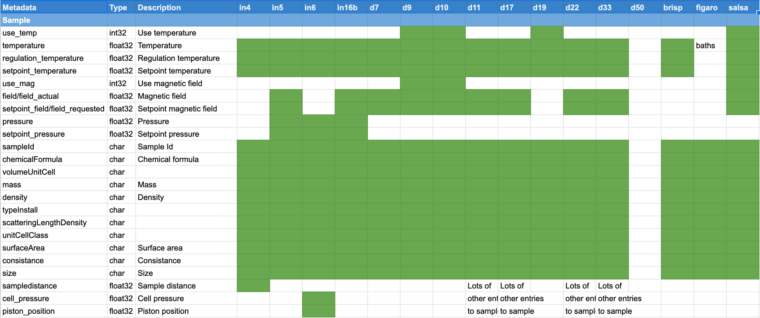
Interoperable
Review of “ILL” NeXus metadata definition, in the scope of WP3

Slide 8
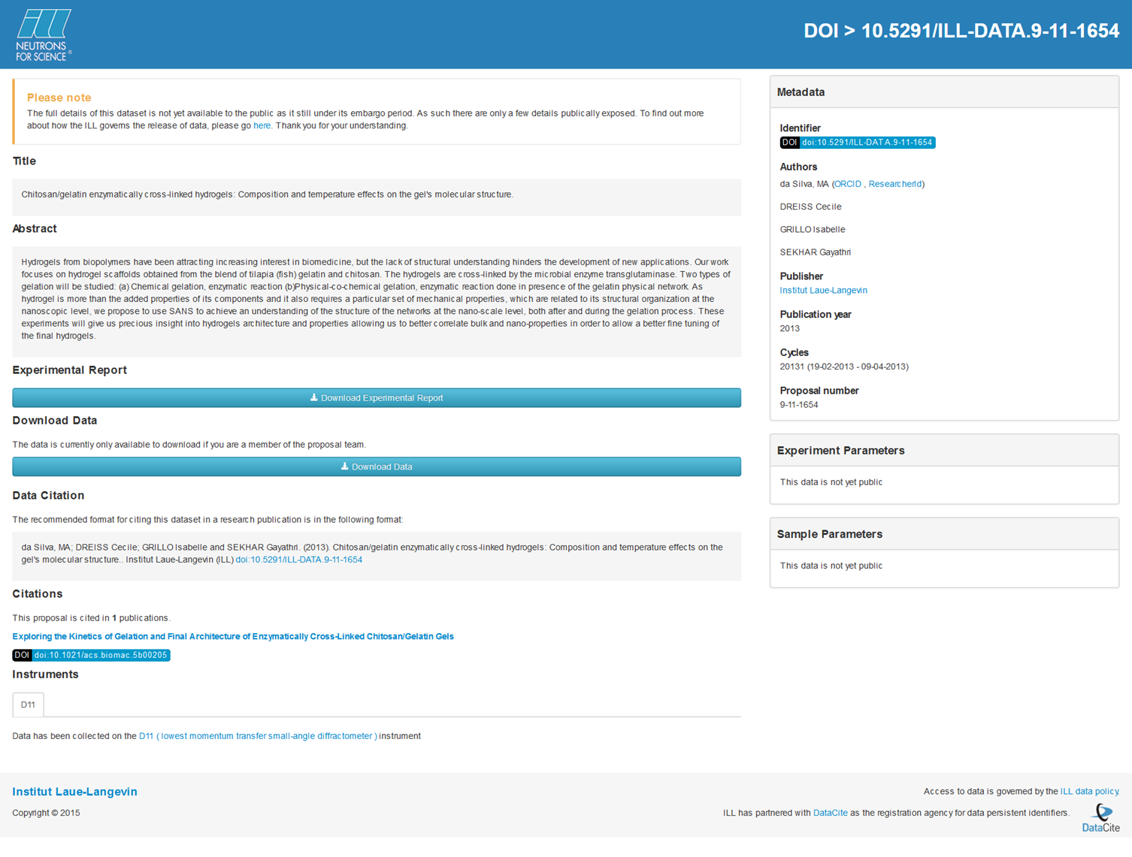
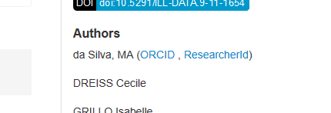
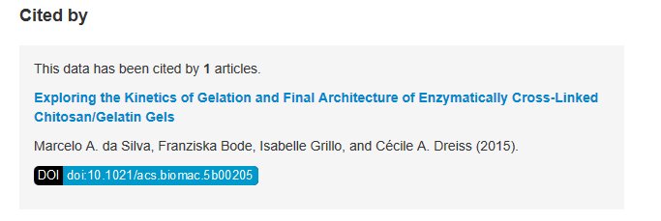
Findable
Linking data and people through ORCID/ResearcherID
DOI
4056 DOIs registered since 2012
Collaboration with DataCite - CNRS INIST
Linking data with publications

Slide 9
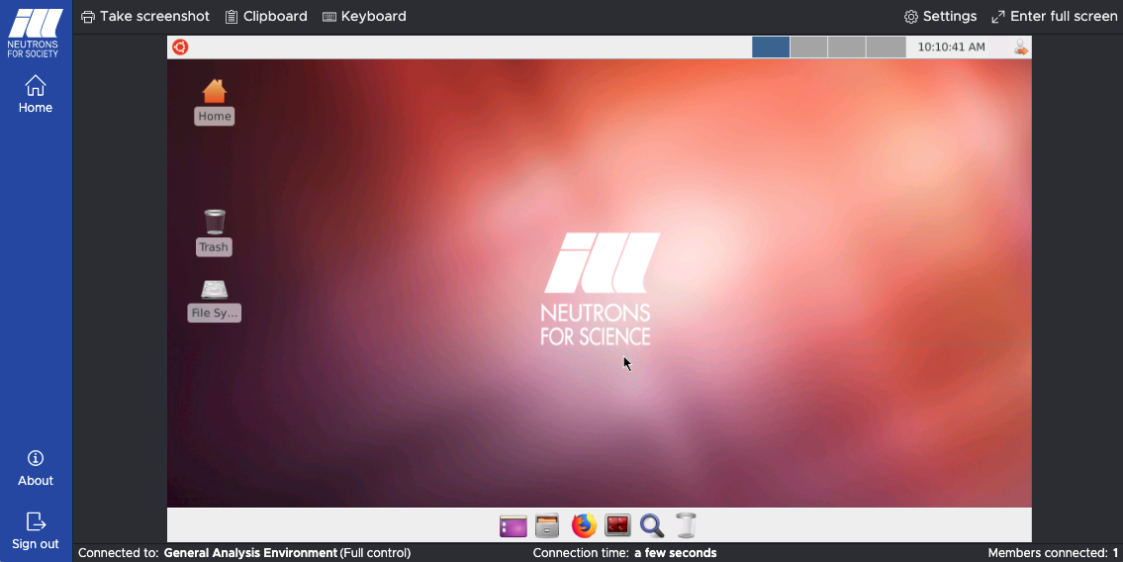
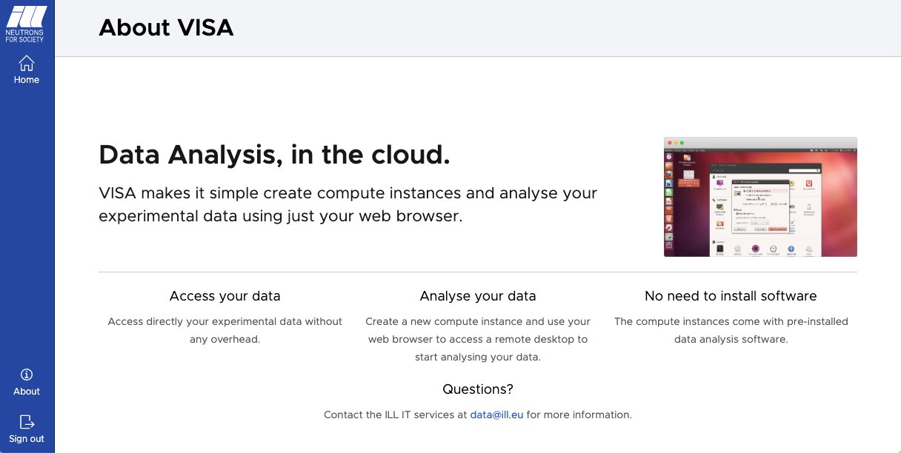
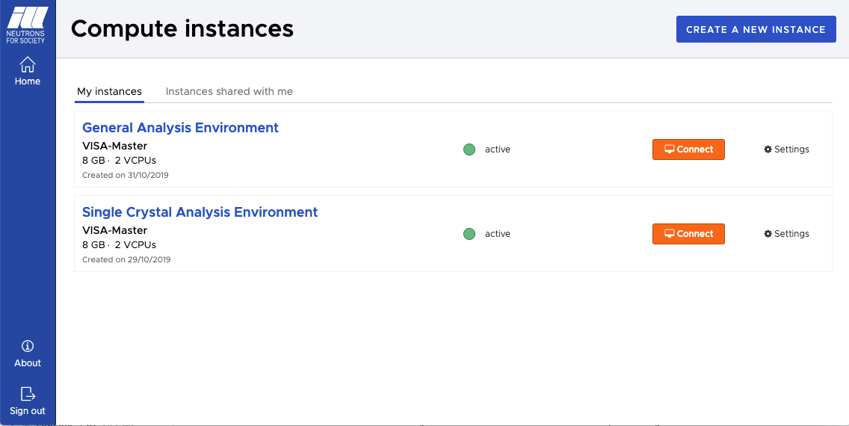
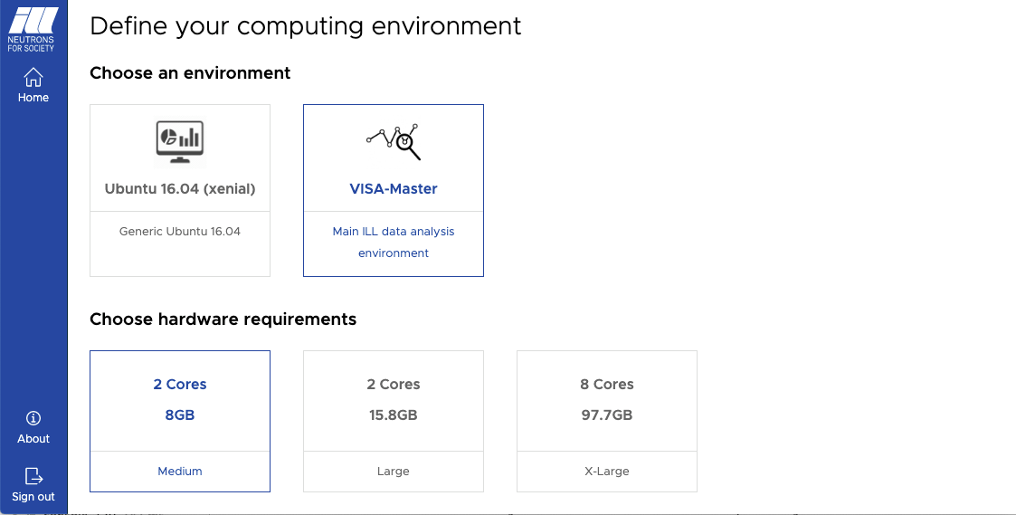
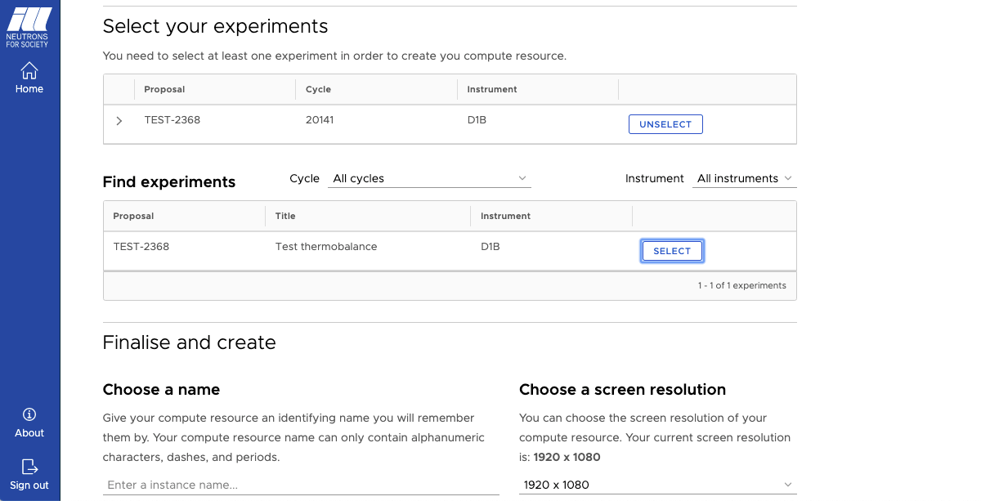
(Re)Usable: DAaS Visa

Slide 10
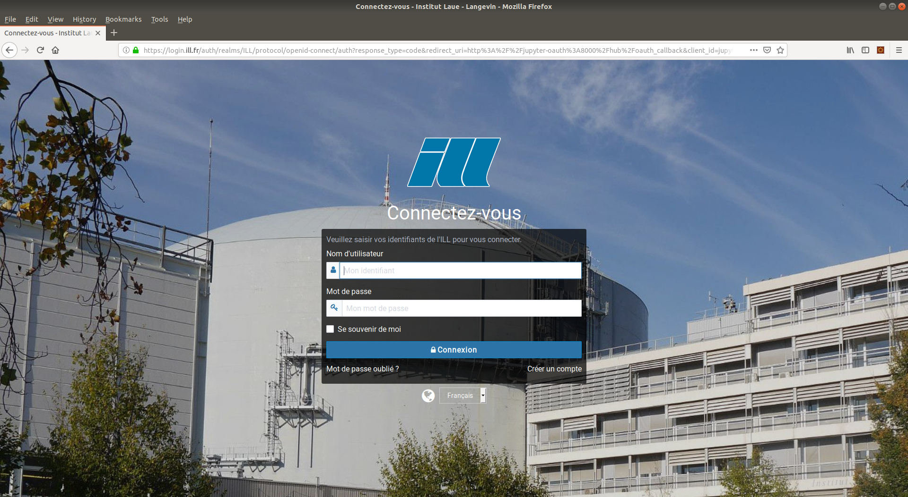
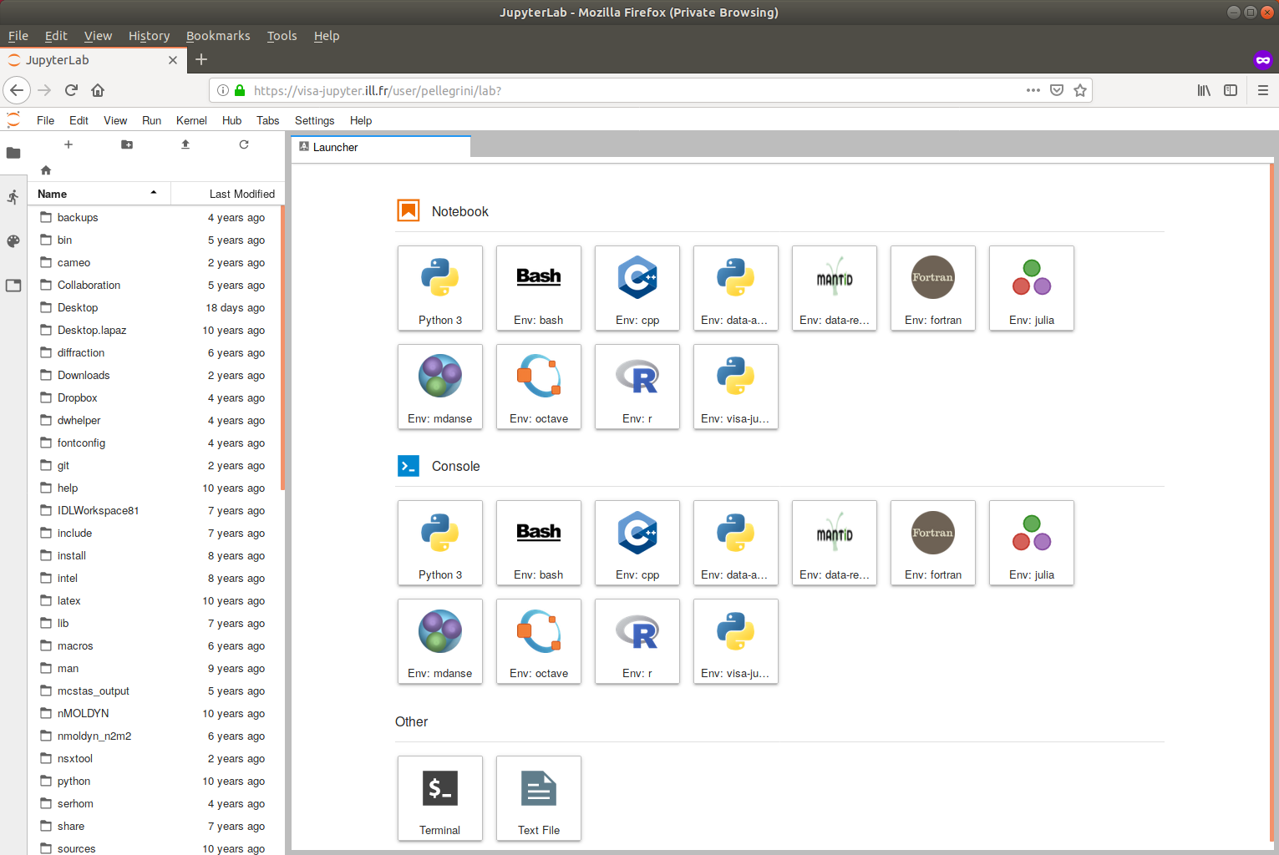
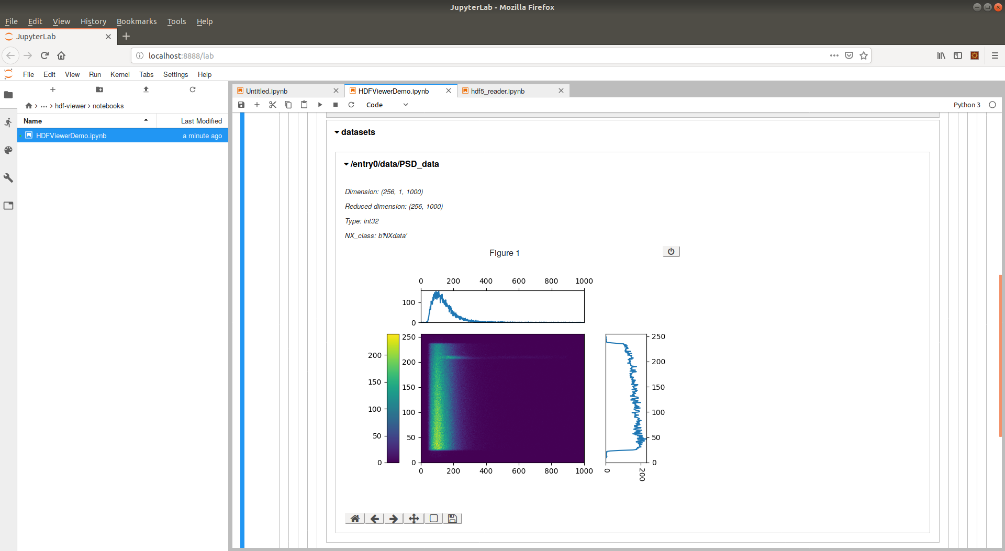
(Re)Usable: DAaS Jupyter

Slide 11
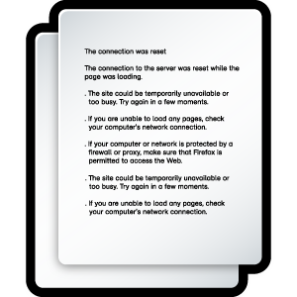
Are we successful? PUMA-BI
A tool to find and rank similarities between proposal documents and scientific articles
Matching of :
DOIs
Proposal codes
Persons
Person laboratories
Keywords
Chemical formulaes
Instrument
Document full text
Document abstract
Document title
Images
Data-sources
Document
Corpus creation
Corpus of
document
Document analysis
Enhanced
document
Document matching
Match
candidate
Human validation
Match
Statistics computation
Result
presentation
Notes:
For matching we use previously data

Slide 12
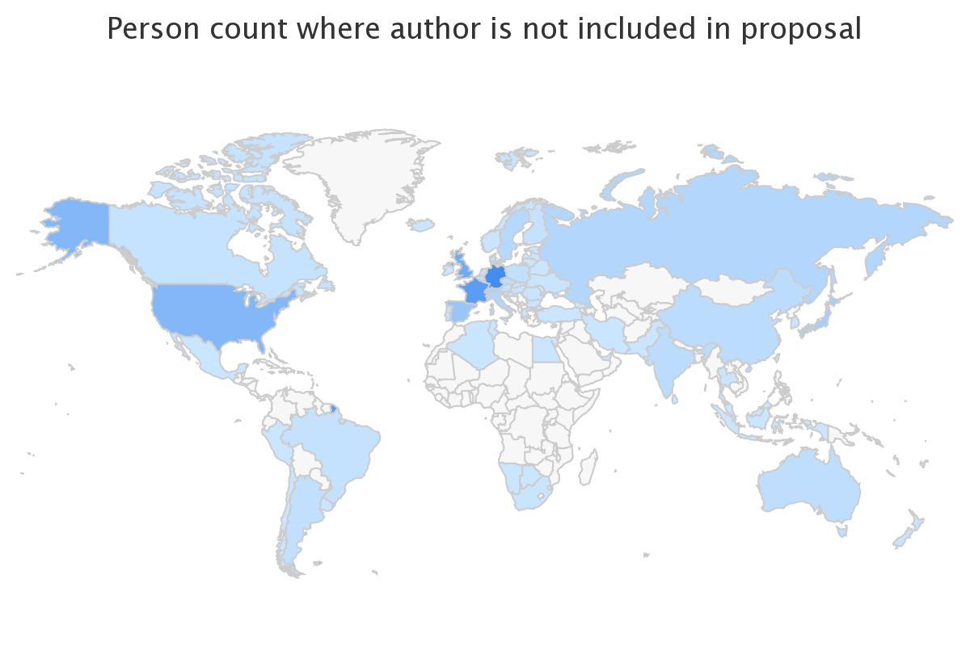
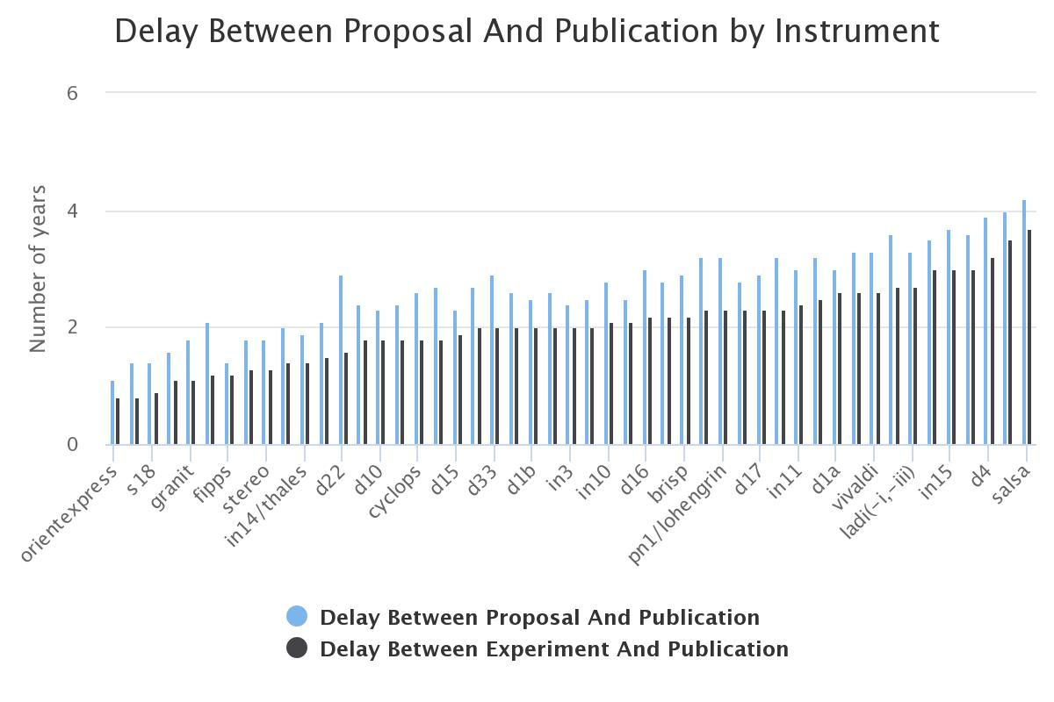
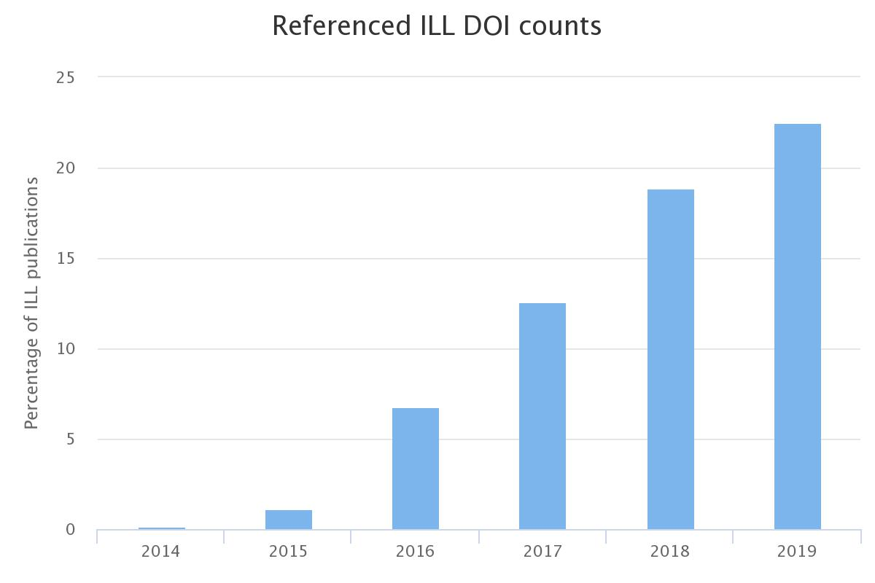
PUMA-BI: statistics examples

Slide 13
Some results (Oct 2019)
1325 Data sets openly accessible
70 Access authorisation added after the experiment (articles reviewers, new collaborations, …).
184 Full Open Data Sets downloaded by non proposal members.
7.5 M data files
downloaded since 2015
Year | Dowload by proposal members | by NON proposal menbers
2015 | 80925 | 157
2016 | 708387 | 20434
2017 | 552841 | 5339
2018 | 2654162 | 53098
2019 | 3410658 | 12868

Slide 14

Impact of Open Data
Nb of scientific articles referencing ILL open data and where data have been downloaded by non proposal members.

Slide 15
Impact of Open Data: how do we count?
Data downloaded by non proposal members, where the name of the downloader appears in the list of authors in the publication.
Should we only count when no proposal members appear in the list of authors?
What to do when the downloader has the same affiliation than someone from the proposal team?
How to differentiate between a normal publication and one due to the openness of the data? How do we quantify our success?
Should be addressed in a standard way => work for WP7?

Slide 16

Contact: data@ill.eu
Portal: https://data.ill.eu
Policy: https://www.ill.eu/DataPolicy
Software catalogue: https://software.pan-data.eu
PaNData Collaboration: http://pan-data.eu
PaNOSC: https://panosc.eu
Many thanks to team: Jamie, Stuart, Eric, Fabien, Holger,
Philippe, William
and also for those who contributed but have currently left ILL: Stéphane, Sylvain, Anton, …

